Slide 1
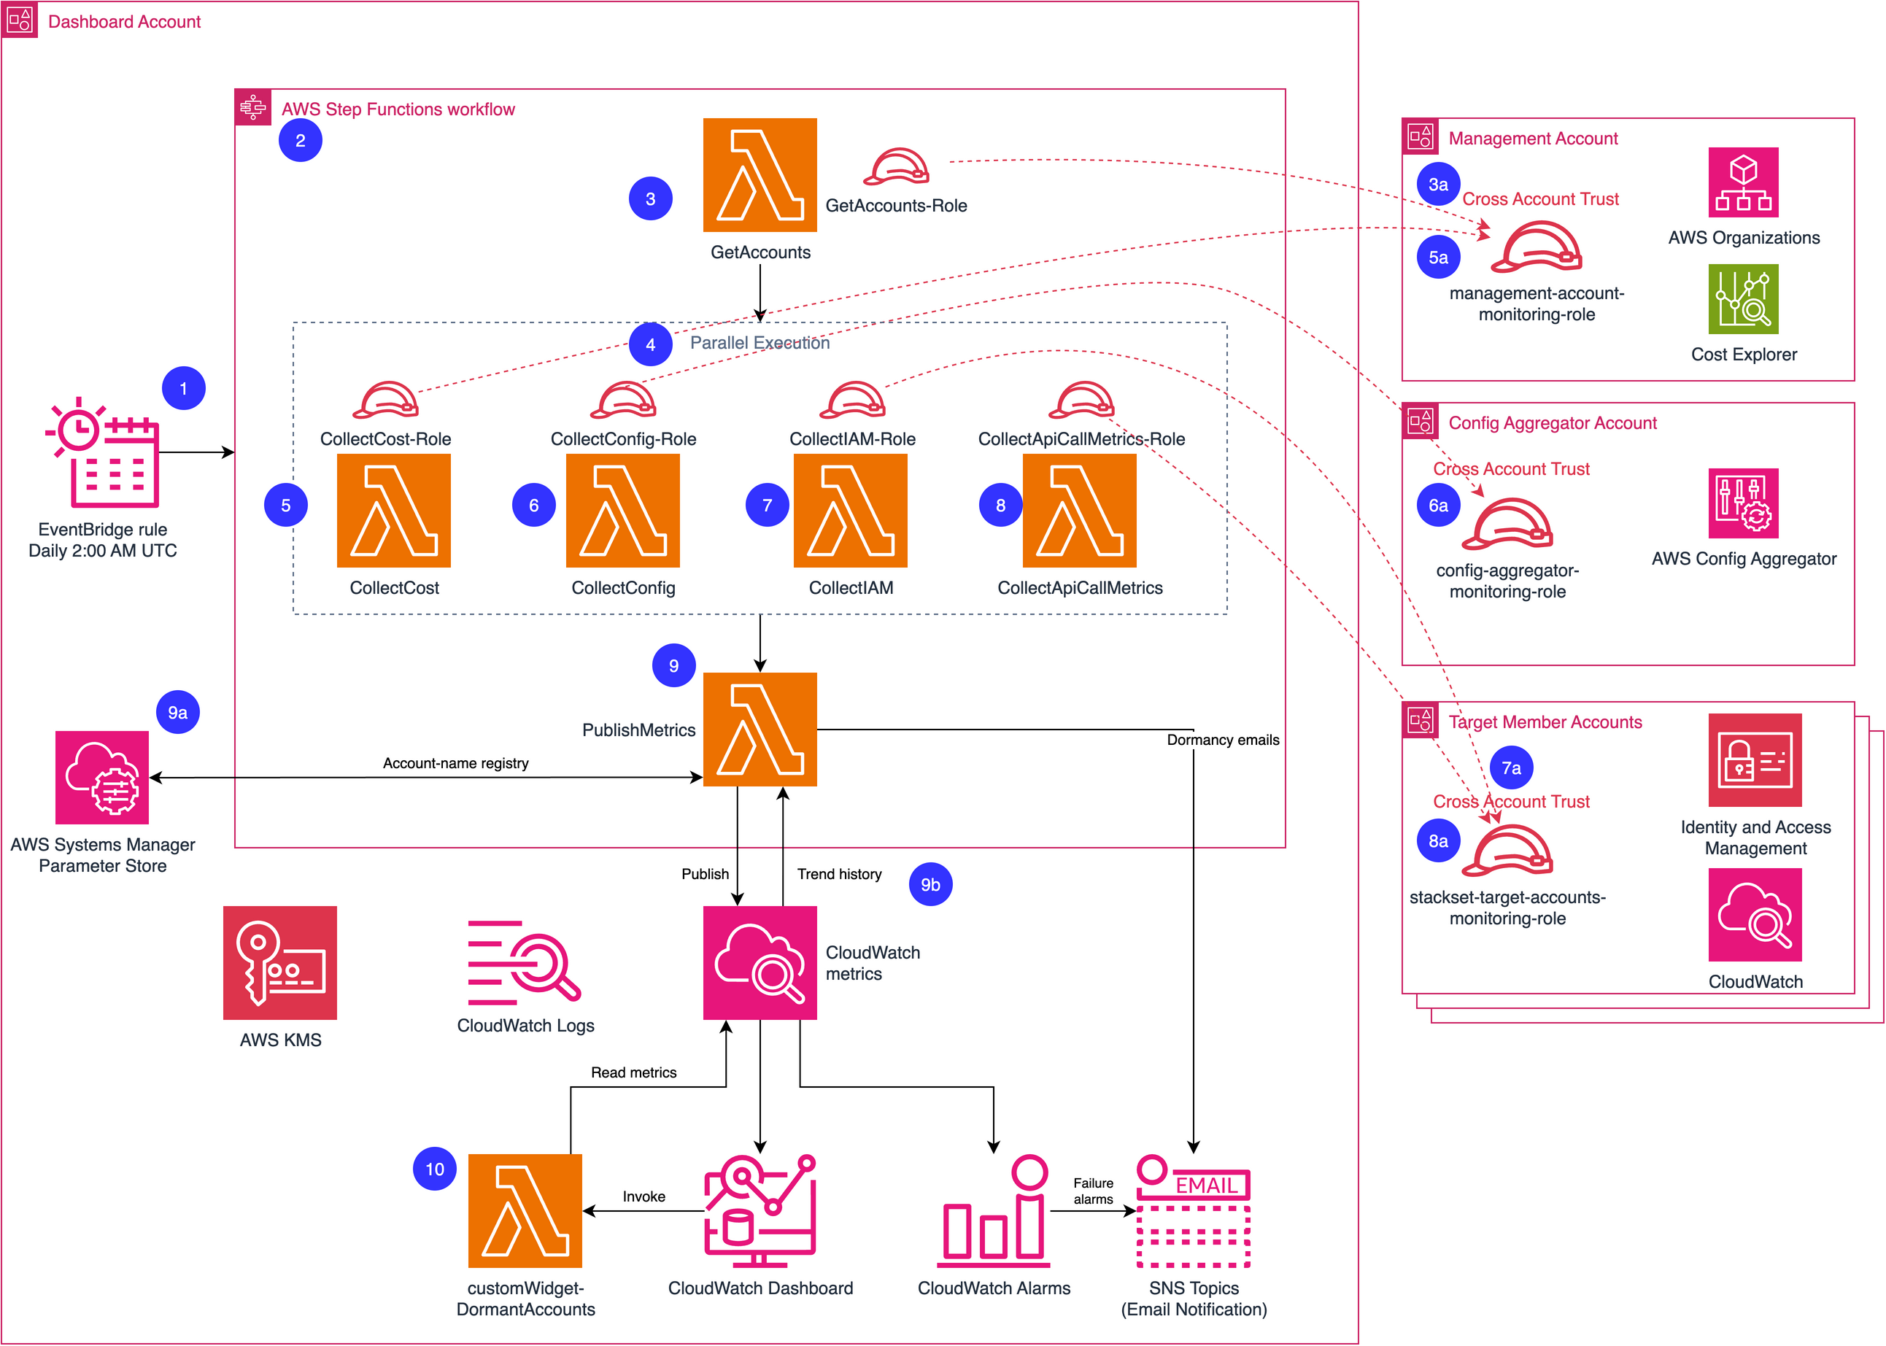
Dormant Account Detection Dashboard — target architecture (numbered steps)

Slide 2
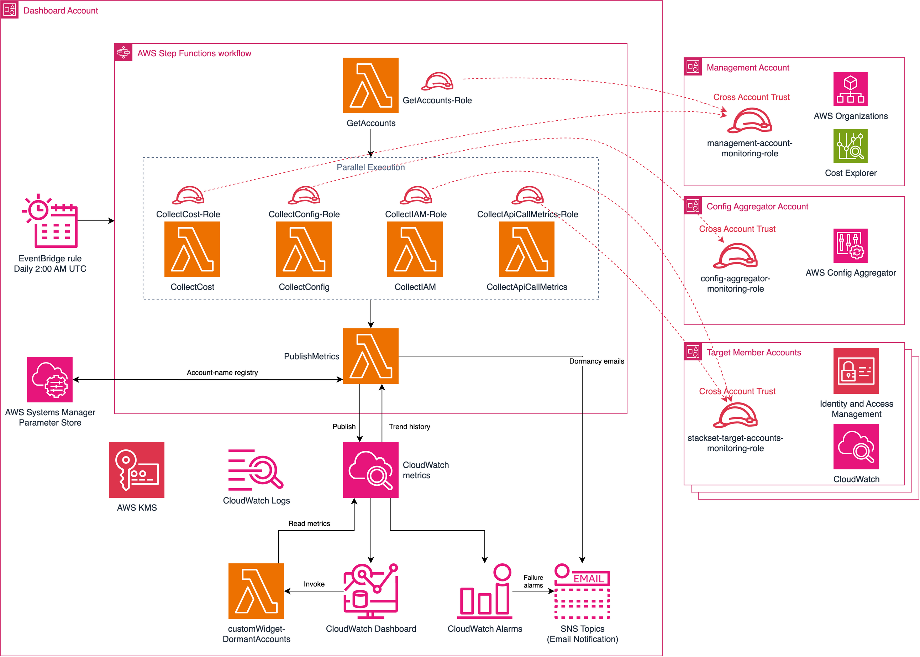
Dormant Account Detection Dashboard — target architecture

